Slide 1
Interlude - GPUs

Slide 2
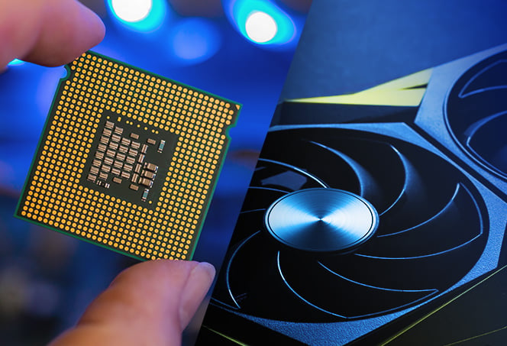
What is a GPU?
Graphics Processing Unit
Graphics/Gaming
Video Editing + Rendering
Scientific Computing
Bioinformatics
Image Processing
Machine Learning

Slide 3
GPU Resources
jaws (disabled)
1 x NVIDIA Tesla V100 (16GB)
5,120 CUDA + 640 Tensor cores each
thanos (not on gpu queue)
2 x NVIDIA Tesla V100 (32GB)
5,120 CUDA + 640 Tensor cores each
twiki
2 x NVIDIA Quadro RTX 8000 (48GB)
4,608 CUDA + 576 Tensor + 72 RT cores each
9 x 2023 nodes
4 x NVIDIA A100 (80GB)
6,912 CUDA + 432 Tensor cores each
6 x 2024 nodes
2 x NVIDIA L40S (48GB)
18,176 CUDA + 568 Tensor + 142 RT cores each
518,808 GPU cores alone!

Slide 4
GPU Resources
Type | Architecture | Memory | #cards | Nodes | CUDA Cores | RT Cores | Tensor Cores
Tesla V100 | Volta | 16GB | 1 | jaws | 5,120 | - | 640
 |  | 32GB | 2 | thanos
Quadro RTX 8000 | Turing | 48GB | 2 | twiki | 4,608 | 72 | 576
NVIDIA A100 | Ampere | 80GB | 36 | 9 x 2023 | 6,912 | - | 432
NVIDIA L40S | Lovelace | 48GB | 12 | 6 x 2024 | 18,176 | 142 | 568
 |  |  |  |  | 491,520 | 1,848 | 25,440 | 518,808

Slide 5
Why do we use GPUs?
Both CPUs and GPUs work in fundamentally different ways:
A CPU handles the majority of the processing tasks for a computer.
fast and versatile
built to handle any number of required tasks
accessing hard drive storage
logging inputs
moving data from cache to memory
That means that CPUs can bounce between multiple tasks
A GPU is designed from the ground up to render high-resolution images and graphics almost exclusively
This doesn’t require a lot of context switching
GPUs focus on concurrency, or breaking down complex tasks.
Notes:
This parallelisation is different to SLURM parallelisation from yesterday
How many operations we can get through a specific set of resources at any one time

Slide 6
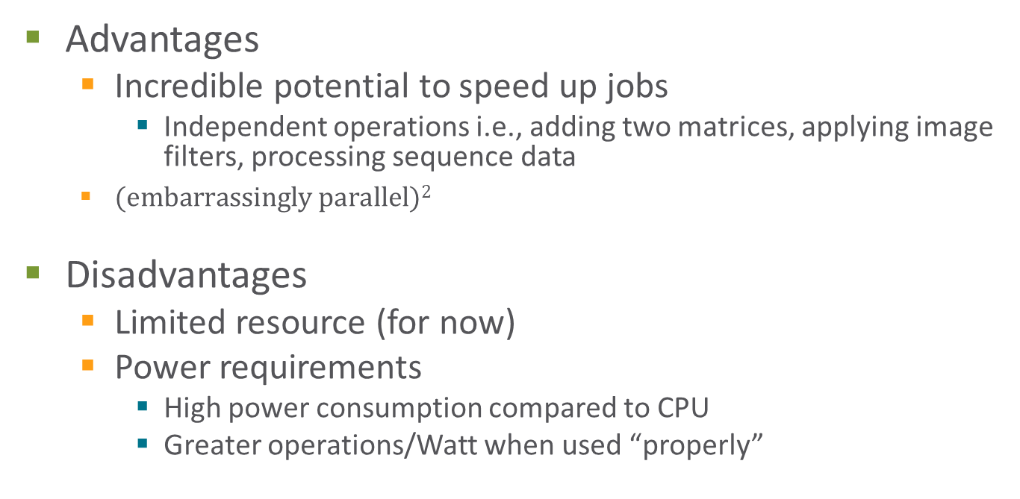
Why do we use GPUs?
Advantages
Incredible potential to speed up jobs
Independent operations i.e., adding two matrices, applying image filters, processing sequence data
$(embarrassingly parallel)2$
Disadvantages
Limited resource (for now)
Power requirements
High power consumption compared to CPU
Greater operations/Watt when used “properly”

Slide 7

GPUs vs CPUs
CPU – 16C (32T)
GPU – >1000C

Slide 8
GPUs vs CPUs
CPU
GPU
Control
ALU
ALU
ALU
ALU
Cache
Memory (DRAM)
Memory (VRAM)
CPUs have to allocate more physical space on a chip to memory caches and controllers
This is what allows for such low latency
But limits the ability to do lots of simultaneous tasks

Slide 9
Speed Increases from Parallelisation
CPU
(Low Latency)
T₁
T₂
T₃
T₄
Processing
T₄
Idle
GPU
(High Throughput)
T₃
Ready
T₂
T₁
Notes:
10,000 images
12s/image CPU - >33hrs 8.3 kWh
0.5s/image GPU – 1hr 20 mins 1.33 kWh

Slide 10
Allocating GPUs
If you need to use a GPU, you must specify the queue and ask for it:
Or define the relevant parameters in an sbatch file:
$ srsh --partition=gpu --gpus=1 …
srun: job <jobID> queued and waiting for resources
srun: job <jobID> has been allocated resources
#!/bin/bash
#SBATCH --partition=gpu
#SBATCH --gpus=1
…

Slide 11
Allocating GPUs
Alternatively specific card types can be requested:
--gpus=a100-sxm4-80gb (2023 nodes)
--gpus=rtx_8000 (twiki)
The number of cards requested can also be specified:
--gpus=a100-sxm4-80gb:2
--gpus=a100-sxm4-80gb:8 etc.
$ sinfo -o "%50N %10c %20m %30G "
NODELIST CPUS MEMORY GRES
n17-28-256-boomer,n17-28-256-starbuck,n17-28-1536- 4+ 7000+ (null)
n19-24-192-jaws 48 180000 gpu:v100-pcie-16g:1(S:0)
n23-64-512-nagini,n23-64-512-pigwidgeon 128 495000 gpu:a100-sxm4-80gb:4(S:0-1)
n21-16-256-twiki 32 250000 gpu:rtx_8000:2(S:0-1)
n19-64-3072-thanos 128 3094000 gpu:v100-pcie-32g:2(S:0,3)

Slide 12
Allocating GPUs
Simply requesting a GPU is often not enough so ensure that the job/tool is also appropriate for hardware acceleration
GPU enabled versions of tools/pipelines
Ensure any CLI options for hardware acceleration are used
Additionally, with the installation of the new nodes select resources that make sense for your application
A100s – multi-GPU training, large models and datasets
L40S – single card training, inference
Select a GPU based on the utilisation of the GPU’s memory
A100s – 80GB
RTX 8000s – 48GB
L40S – 48GB

Slide 13
Monitoring GPU usage
Running nvitop –m from an active terminal on the will produce a top-like interface
Driver and CUDA versions
GPUs allocated to a particular job or located in a particular node
Current GPU utilisation, VRAM usage, and Memory Bus utilisation and ticker of historic utilisation
CPU and Memory usage
Currently running processes
Very useful for setting up and monitoring a GPU job
Maximising the size of a model/dataset
View behaviour over time to spot any issues
Notes:
Really useful for setting GPU parameters relating to dataset/model size

Slide 14
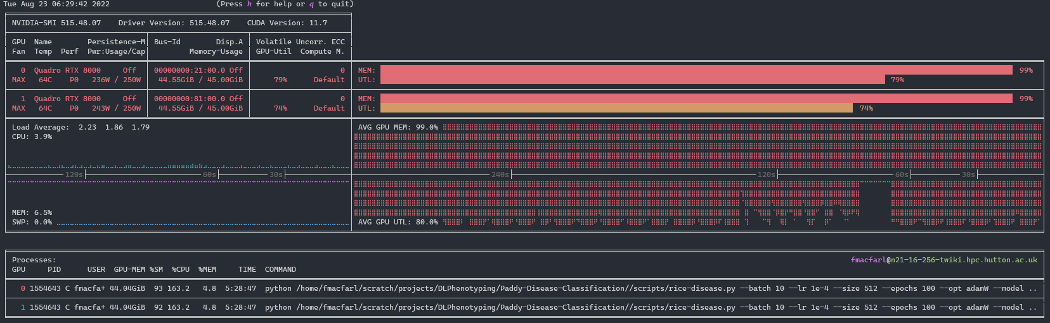
Monitoring GPU usage
[fmacfarl@twiki ~]$ nvitop –m
Driver and CUDA versions
Ticker showing utilisations over the last few minutes
Graphical output of current memory usage and utilisation
Individual GPUs in the node
GPU Memory Usage in MB and %age total
Processes currently running
Similar outputs for CPU and RAM usages

